Slide 1
Detection of Artificial Intelligence Generated Images
Riski Adianto
Saira Faiz
Colby Jamieson
Karl Yazigi

Slide 2
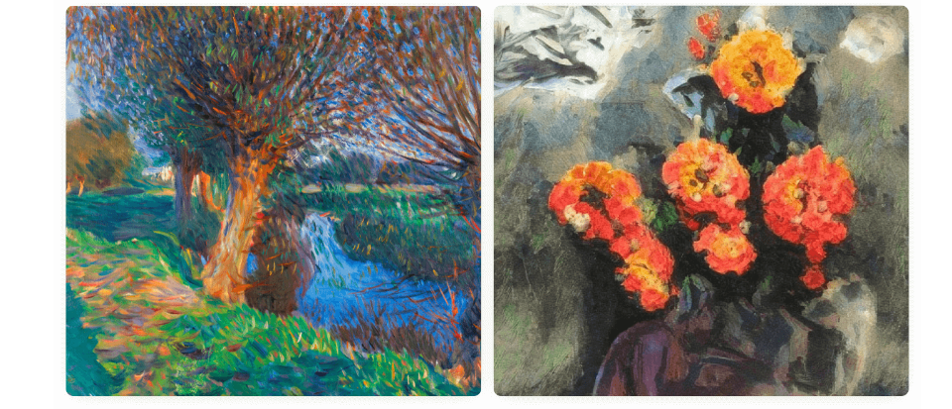
Introduction
What do you think?
Which one is a real painting and which is AI-generated.
A
B
A is a real painting and B is AI-generated.
B is a real painting and A is AI-generated.

Slide 3
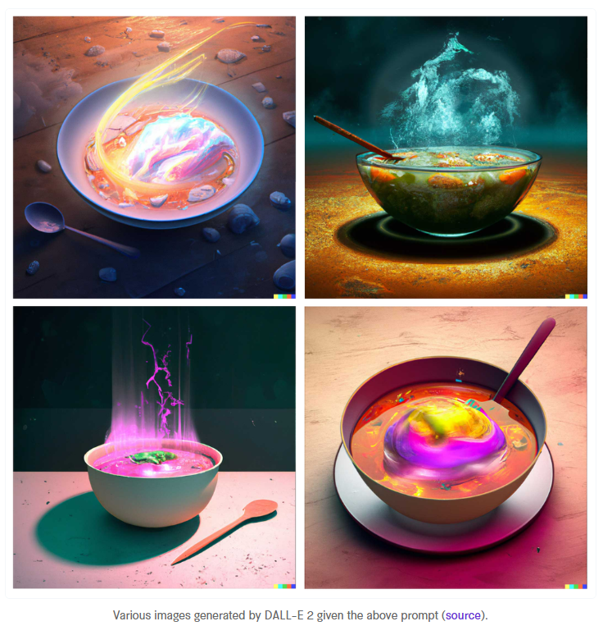
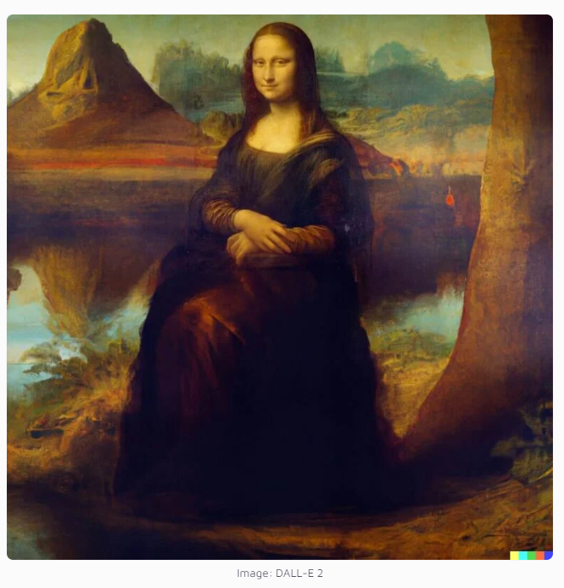
Introduction
What are the capabilities of DALL-E
DALL-E 2 can create photorealistic images based on prompts and textual description.
DALL-E 2 can modify or extend existing images.
Edits features such as hairstyle, nose, face, gender.
Create background based on textual description.

Slide 4
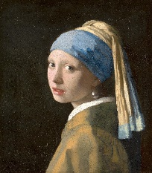
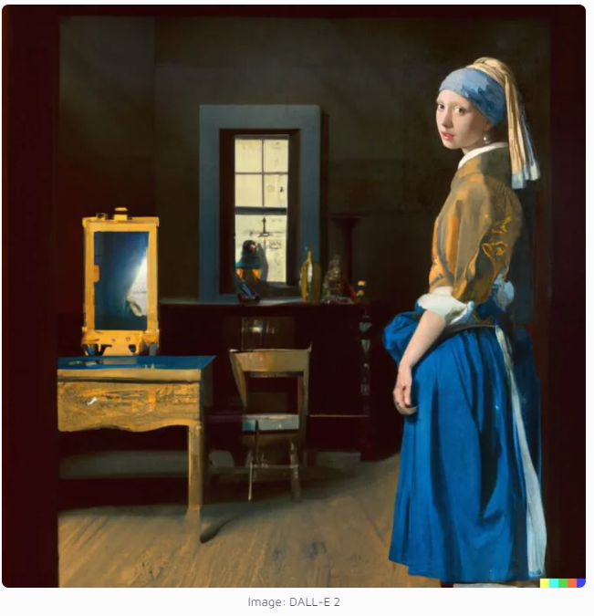
Introduction
Shortcomings of AL generated images
It’s still difficult to draw certain parts of the body, like hands.
It can mix different images.

Slide 5
Objective & Scope
Whether the model can detect, if the image is AI generated.
Automated identity verification, forensics. Deepfake technology.
Improve the capabilities of AI
By developing algorithms that can distinguish between images generated by machines and those captured by humans.
Robotics, autonomous vehicles, and surveillance systems.

Slide 6
Related Work
Sentence:
Sub-sentence

Slide 7
Methodology
Probably include Theory/Background on Convolutional neural networks as well as how dall-e works:
Sub-sentence

Slide 8
Data Collection
Dall-e images were scraped from the website: 'https://dalle2.gallery/#search-random’:
Human made images were scraped from google using different search keywords, you can find the keywords used for this in the data scrape.ipynb file saved as a list “categories”.
Images are various styles of art (cartoon, oil painting, digital art, anime etc) and photorealistic images (humans, animals, outdoors etc) for both Dall-e and human made images
Images were left in RGB format as an array. So an array of shape(255,245,3). Values were scaled to be between 0->1
Images cropped to avoid fitting to watermarks

Slide 9
Model Details
Convolutional Neural Network (CNN) to classify images into two categories: "Human" and "DALLE-2".
Two sets of convolutional layers, each followed by max pooling, and two fully connected (dense) layers with ReLU activation function and a final output layer with sigmoid activation function.
Notes:
Used a convolutional network for the model. Shape and size of the neural network can be found on the train-results.ipynb file:
Sub-sentence

Slide 10
Training & Testing
Training is performed for 10 epochs, with each epoch using a different batch of data from 1800 images (split evenly between human and DALLE-2 generated images)
Testing performed on batch of 930 DALLE-2 and 650 human generated images data
“Adam” optimizer is used with a learning rate of 0.00005
Binary cross-entropy loss function is used to calculate the loss during training
Notes:
Model was trained for 10 epochs on 5 batches of 1800 images. So a total of 9000 images were used to train the model split equally between DALL-E generated and Human made images:
Sub-sentence
Test batch was 1580 images 930 of which were dall-e generated and 650 human made:
Sub-sentence

Slide 11
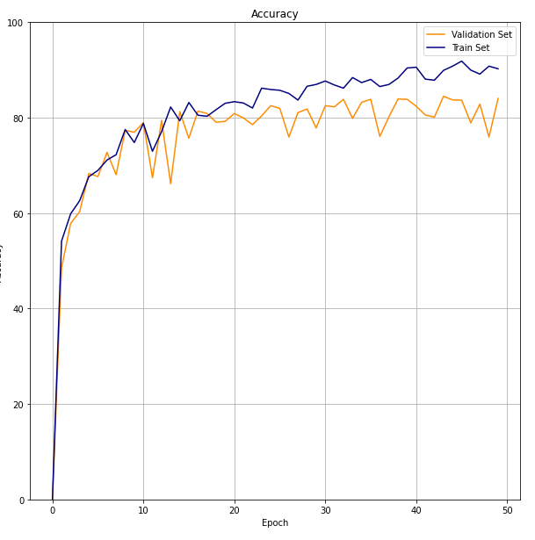
Results: Accuracy
Optimal validation set accuracy ~80% around 20 epochs
Notes:
The 50 epochs on the graph for accuracy are because of the 10 epochs for 5 batches (10x5 = 50):
I’ve made graphs of accuracy, confusion matrix (for fp tp fn and tn rates), and the ROC and AUC curve
Sub-sentence

Slide 12
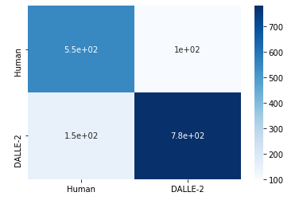
Results: Confusion Matrix
Confusion Matrix
100 incorrectly labeled DALLE-2 images
150 incorrectly labeled human-made images
Predicted
Actual
Notes:
The 50 epochs on the graph for accuracy are because of the 10 epochs for 5 batches (10x5 = 50):
I’ve made graphs of accuracy, confusion matrix (for fp tp fn and tn rates), and the ROC and AUC curve
Sub-sentence

Slide 13
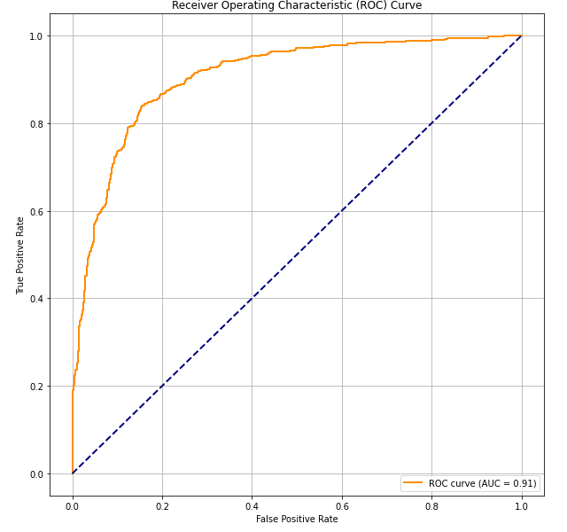
Results: Confusion Matrix
Area under curve: 0.91
High performing sensitivity and specificity trade-off
Relatively high true positive and low false positive rate
Notes:
The 50 epochs on the graph for accuracy are because of the 10 epochs for 5 batches (10x5 = 50):
I’ve made graphs of accuracy, confusion matrix (for fp tp fn and tn rates), and the ROC and AUC curve
Sub-sentence

Slide 14
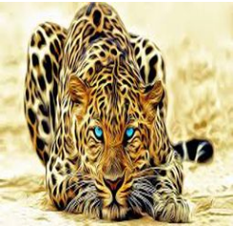
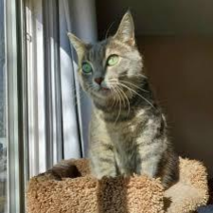
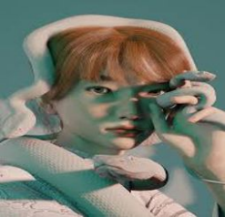
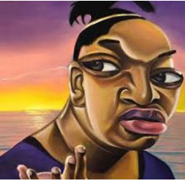
Results: Human Art
Prediction: human (0.00014)
Prediction: human (0.11)
Prediction: DALLE (0.84)
Prediction: DALLE (0.60)

Slide 15
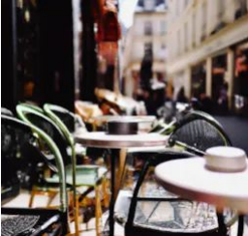
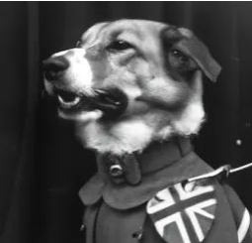

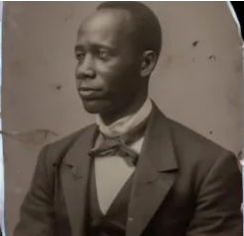
Results: DALLE Art
Prediction: DALLE (0.997)
Prediction: DALLE (0.89)
Prediction: human (0.19)
Prediction: human (0.42)

Slide 16
Discussion
Ideas:
Scalability
Limitations
Future work
Importance of work and usage

Slide 17
Summary
Sentence:
Sub-sentence

Slide 18

Thank You

